Slide 1




LIBRARY MANAGEMENT SYSTEM

Slide 2
TEAM MEMBERS
AQIB ALI
ALOK KUMAR
M. AHMAD
SOFTWARE DESIGN
DEVELOPMENT
DATABASE INTEGRATION
GUI
SOFTWARE DESIGN
DEVELOPMENT
TESTING
RESEARCH
SOFTWARE DESIGN
DEVELOPMENT
TESTING
DOCUMENTATION

Slide 3
Background
Efficient Library Management is crucial for enhanced performance and increased productivity in today’s digital world. Many librarians struggle with handling large volumes of data in the form of books, magazines, newspapers and other reading materials. It becomes more hectic to look after all these especially when they are in thousands. Seeing these problems the proposed project aims to develop a Library Management System (LMS) to digitalize, automate and streamline the tasks daily occurring in a library.

Slide 4
Problem Statement
Managing library resources manually is time-consuming and prone to errors, including misplaced books, inconsistent record-keeping, and difficulties in tracking borrowing and return activities. A Library Management System is needed to streamline operations, improve resource tracking, and provide users with easy access to book information.

Slide 5
TOOLS AND TECHNOLOGIES
VISUAL STUDIO AS IDE
C++ PROGRAMMING LANGUAGE
MY SQL FOR DATABASE
SFML FOR GUI
GITHUB FOR CODE SHARING

Slide 6
FEATURES
STUDENT
LIBRARIAN
VIEW BOOKS
SEARCH BOOKS
ISSUE BOOKS
RETURN BOOKS
ADD BOOKS
REMOVE BOOKS
VIEW BOOKS
MODIFY BOOKS
VIEW ISSUED BOOKS
REGISTER STUDENTS
REMOVE STUDENTS
VIEW STUDENTS
MODIFY STUDENTS

Slide 7
CONCEPTS USED
VARIABLES
FUNCTIONS
CLASSES
POINTERS
FILE HANDLING
DATABASE
LOOPS

Slide 8
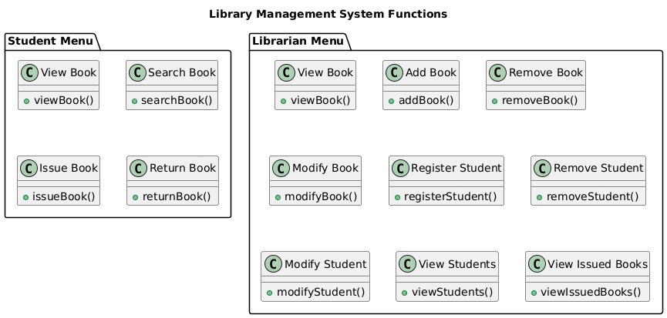
MODULARITY

Slide 9
FLOW DIAGRAM

Slide 10
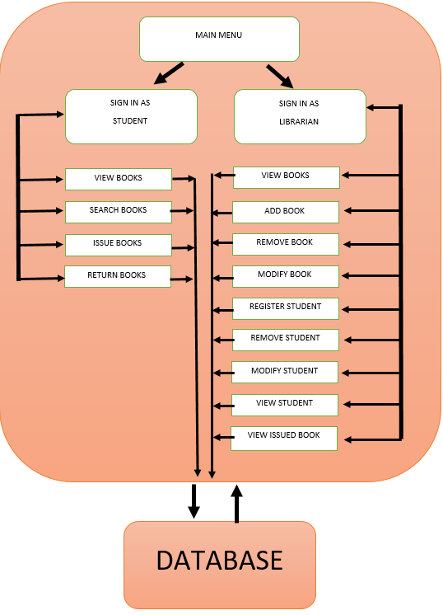

Slide 11
DEMO

Slide 12
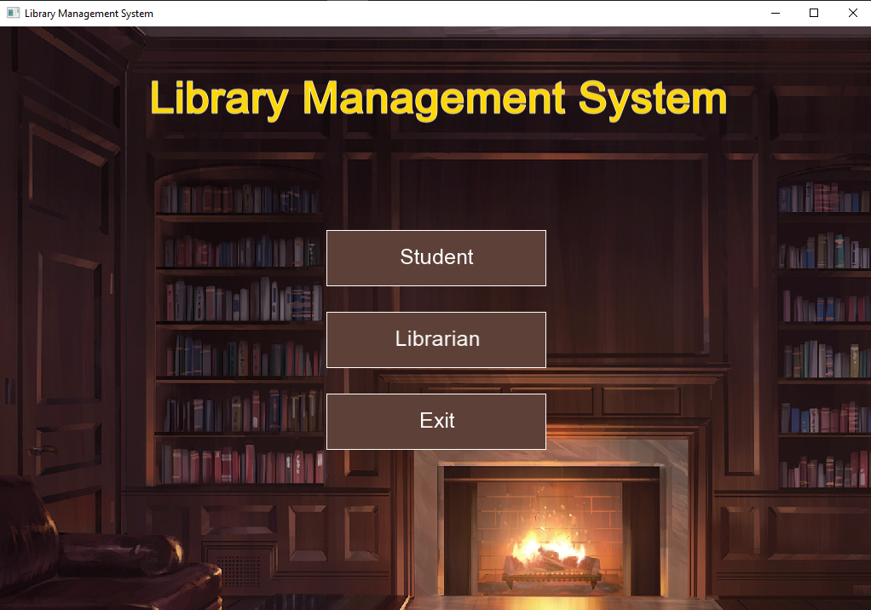

Slide 13


Slide 14


Slide 15


Slide 16
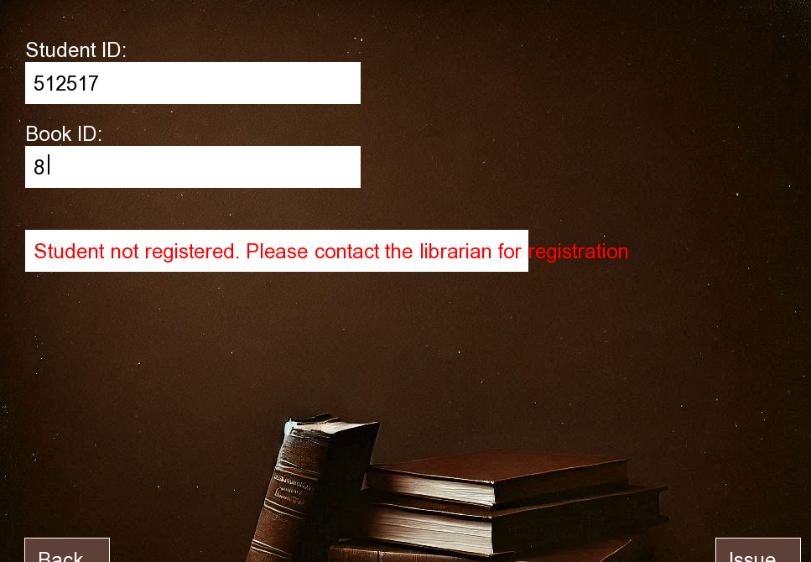

Slide 17
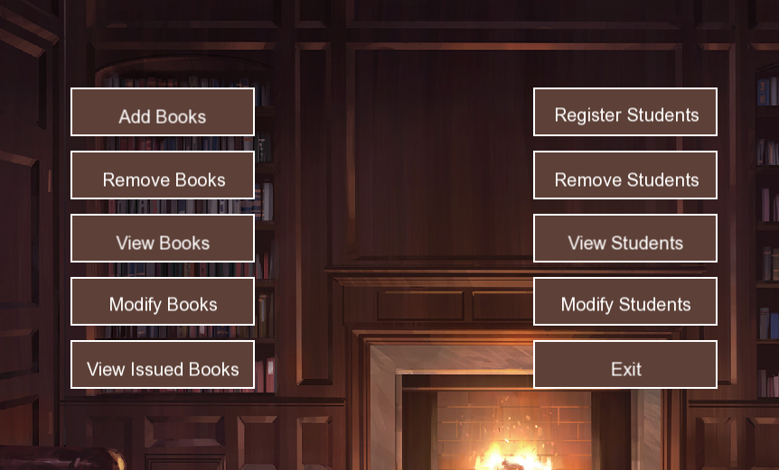

Slide 18
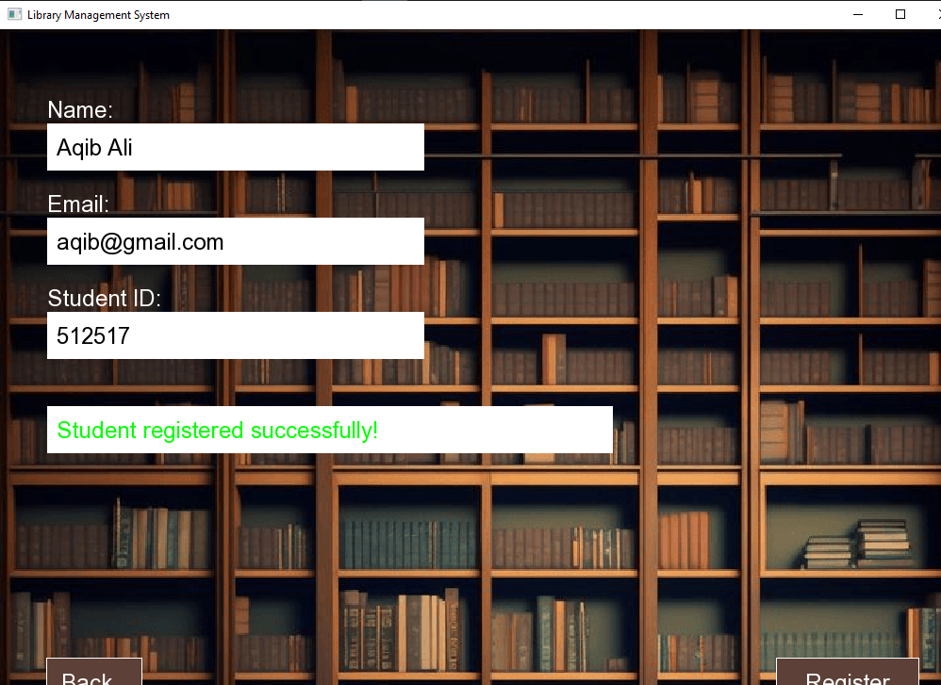

Slide 19


Slide 20


Slide 21


Slide 22
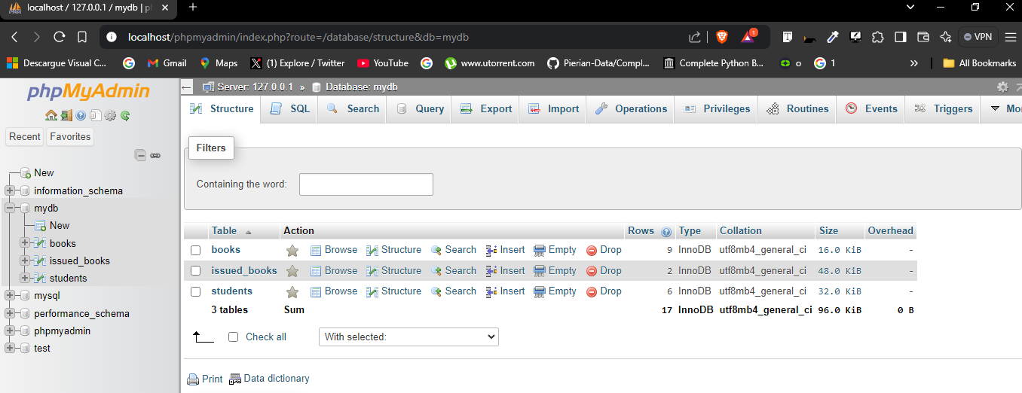

Slide 23
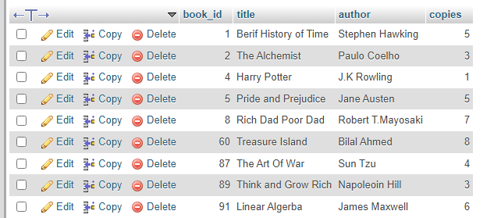

Slide 24


MARKET VALUE
The market value of a library management system lies in its ability to cater to small libraries, schools, and community organizations seeking affordable and efficient solutions. It can be used to streamline, automate and speedup the operations. Currently, most of the libraries lacks such software and therefore provides a fruitful opportunity for us. Presently, Such softwares has a market value of around 100$ - 500$.

Slide 25
THANK YOU

